Slide 1
Money and the Financial System

Slide 2
The Modern Financial System
The Role of the Financial System
Financial System: it is a system where the activities involved in finance take place.
This encompasses the markets, firms, and other which carryout the financial decisions of households, businesses and government.
Financial Markets: this is the market which allow people to buy and sell products consists of financial instruments like stocks and bonds.
Important financial markets are Money market, stock markets, bond markets, and foreign exchange markets.
Financial intermediaries: institutions which provides financial services and products.
Important financial intermediaries are : commercial banks, insurance companies, pension fund, mutual funds etc.

Slide 3
The functions of the Financial System
The major functions are:
The financial system transfers resource across time, sectors, and regions.
This function allows investments to be devoted to their most productive uses rather than being bottled up where they are least needed.
The financial system manages risk for the economy.
Risk management is like resource transfer : it moves risk from those people or sectors that most need to reduce their risks and the risks to others who are better able to weather them.
The financial system pools and subdivides funds depending upon the need of the individual saver or investor.
Clearinghouse function: it facilitates transaction between payers (purchasers) and payees (sellers).
e.g., when you write a check to buy a new computer, a clearinghouse will debit your bank and credit the bank of the company selling the computer.

Slide 4
The Flow of Funds Tracks Financial Flows in the Economy
Household purchase
Government bond or XYZ stock
Firm sells bonds or has IPO of stock
_{Financial}
_{Market}
Savers
Investors
Mutual fund buys diversified portfolio of stock
_{Financial}
_{Intermediaries}
Household deposits monthly salary into checking A/c
Small business borrows from banks to invest in pizza oven

Slide 5
Financial Assets
Financial assets are claims by one party against another party.
The major financial instruments or assets are:
Money
Saving accounts
Credit market instruments(e.g. mortgages, corporate securities)
Govt stocks and bonds
Money market funds and mutual funds
Pension funds
Financial derivatives

Slide 6
Interest Rates
The interest rate is the price paid for the borrowed money. We usually calculate interest as percent per year on the amount of borrowed funds. There are many interest rates depending upon the maturity, risk, tax status, and other attributes of the loan.
How interest works:
Suppose you deposit Rs. 2000 in a saving A/c. at your local bank, where the interest rate on saving A/c. is 4% per year. At the end of 1 year the bank will have paid Rs. 80 in interest into your A/c., so the A/c. will now be worth Rs. 2080.

Slide 7
The Evolution of Money
What is money?
Simply, money is anything that serves as a commonly accepted medium of exchange.
The history of money: Money has a long and fascinating history.
Barter: Exchange of goods for another goods. This system was used for centuries, before the invention of money.
Difficulties in barter systems
1. Need for presence of double coincidence of wants:
For barter to occur between two people, both would need to have what the other wants.
2. Absence of common measure of value:
In a monetary economy, money plays the role of a measure of value of all goods, so their values can be measured against each other; this role may be absent in a barter economy.
3. Indivisibility of certain goods:
If a person wants to buy a certain amount of another's goods, but only has for payment one indivisible unit of another good which is worth more than what the person wants to obtain, a barter transaction cannot occur.
4. Lack of standards for deferred payments:
This is related to the absence of a common measure of value, although if the debt is denominated in units of the good that will eventually be used in payment, it is not a problem.
5. Difficulty in storing wealth:
If a society relies exclusively on perishable goods, storing wealth for the future may be impractical. However, some barter economies rely on durable goods like pigs or cattle for this purpose.

Slide 8
Commodity Money
Money as a medium of exchange first came into human history in the form of commodities. i.e., a great variety of items (e.g. cattle, olive oil, beer or wine, copper, iron, gold, silver, etc.) have served as money.
By the eighteenth century commodity money was almost exclusively limited to metals like silver and gold.
These forms of money had intrinsic value, meaning that they had use value in themselves.
But metallic money has shortcoming because they are scarce.

Slide 9
Modern Money
Modern money is essentially a token - an abstraction. Paper currency is the most common type of physical money today.
Fiat money:
Money which has no intrinsic value and cannot be redeemed for specie or any commodity, but is made legal tender through government decree.
All modern paper currencies are fiat money, as are most modern coins.
Modern forms of money:
When using money anonymously, the most common methods are either coins or banknotes/paper money.
When using money substitutes in such a way as to leave a financial record of the transaction, the most common methods are cheques, debit cards, credit cards, and digital money.

Slide 10
Components of money supply in India
The RBI uses two concepts of money:
M1 (Narrow money ) = currency with the public + demand deposits with bank + other deposits with the RBI.
M2 = M1 + saving deposits with post office saving banks.
M3 (Broad Money) = M1 + net time deposits (i.e. long – term deposits) of bank.

Slide 11
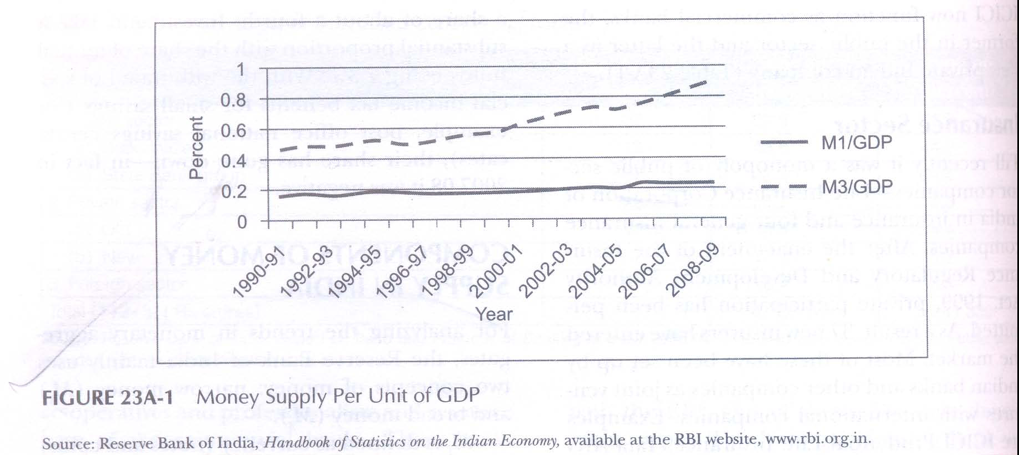
Money supply per unit of GDP
The figure shows that the growth of broad money (M3) in India, particularly since the late 1990s has been much sharper than that of narrow money.

Slide 12
Efficient Markets and Random Walk
What is the essence of the security market theory?
A summary statement is:
“Securities markets are extremely efficient in absorbing information about individual stocks and about the stock market as a whole. When new information arrives, the news is quickly incorporated into stock prices. Systems which attempt to forecast on the basis of the past or of fundamentals cannot produce returns greater than those that could be obtained by holding a randomly selected portfolio of individual stocks of comparable risk.”

Slide 13
Rational for the Efficient-Market View
The theory of efficient market can explain, why well-functioning financial markets rule out persistent excess profits.
An efficient financial market is one when all new information is quickly understood by market participants and becomes immediately incorporated into market price.
“The theory of efficient markets holds that market price contain all available information it is not possible to make profits by acting an old information or at pattern of past price changes. Return of stocks will be primarily determined by their riskiness relative to the market.”

Slide 14
A Random Walk
A price follows a random walk when its movements over time are completely unpredictable.
For example,
toss a coin for heads or tails. Call a head ‘plus 1’ and tail ‘minus 1’ .
Then keep track of the running score of 100 coin tosses. Draw it on graph paper.
This curve is a random walk.
Why do speculative price resemble a random walk?
In an efficient market all predictable things have already built into the prices. It is the arrival of new information that affects stocks or commodity prices. Moreover, the news must be random and unpredictable.

Slide 15
the efficient market views applies to individuals stocks but not necessarily to the market as a whole.
There is persuasive evidence of long, self-reversing swings in stock market prices.
These swings tend to reflect changes in the general mood of the financial community.
Periods like the 1920s and 1990s saw investor optimism and rising stock prices, while the 1930s and 2007-08 were the period of investor pessimism when stock price declined sharply.

Slide 16
INDIA’S FINANCIAL INSTITUTION
Commercial Banks
Regional Rural Banks (RRBs)and Local Area Banks (LABs)
Co-operatives Banks
Non-bank financial companies (NBFCs)
Development Finance Institutions (DFIs)
Insurance Sector

Slide 17
Commercial Banks
Commercial banks dominate the financial sector in India.
The commercial banks account for around 60% of the total assets of the financial institutions.
There are 80 schedule commercial banks (SCBs) grouped into:
Public sector (27): comprises the SBI group, the nationalized bank s and the Industrial Development Bank of India (IDBI).
Old (Indian) private sector (15): for ex, South Indian Bank and Catholic Syrian Bank, are those which were not nationalized by the government in 1969 or later and continued in the private sector.
New (Indian) private sector (7): for ex, Axis Banks and HDFC Bank are those which were set up after the entry of the private sector into banking was liberalized in the early 1990s.
Foreign sector (31): for ex, Citibank, Bank of America, HSBC are those which are owned and controlled by banks from other countries.

Slide 18
Table 23A-1. Total Assets of Scheduled commercial banks
 | Number of Banks | 2007- 08 (percent) | 2008- 09 (percent)
1. Public sector | 27 | 69.9 | 71.9
(a) Nationalized | 19 | 43.5 | 44.2
(b) State Bank Group | 7 | 23.4 | 24.4
2. Private sector | 22 | 21.7 | 19.6
(a) Old | 15 | 4.5 | 4.4
(b) New | 7 | 17.2 | 15.2
3. Foreign Sector | 31 | 8.4 | 8.5
Total (1+2+3) (Rs crores) |  | 4,326,167 | 5,241,330

Slide 19
RRBs
Following the RRB Act of 1976, RRB were set up, jointly owned by the central government, state government and sponsor scheduled commercial bank
the equity being shared in proportion 50:15:35 respectively.
These are supposed to have the local familiarity of the co-operatives and professionalism and resource base of the commercial banks.
These banks function as specialized rural financial institutions for the development of rural area.
During 2008-09, there were 86 RRB with total assets of Rs. 145,824 crore.

Slide 20
Co-operative Banks
Urban co-operative banks (1,721 during 2008-09)
Rural co-operative credit institutions (96,061)
- these are primarily involved in short term lending and have different tiers of operation such as state co-operative banks, and district central co-operative banks, and primary agricultural credit society.

Slide 21
Non-bank Financial Companies (NBFCs)
These companies are categorized into different type such as:
Housing finance company (HFC)
Hire-purchase company
Equipment leasing company
Loan company
Investment company
As on June 2009, there were 12,740 NBFCs registered in the RBI. Out of these 336 were deposit taking types.

Slide 22
Development Finance institutions (DFIs)
These were set up at the initiative of the government to fund activities of long gestation.
Major DFI are:
Industrial Finance Corporation of India (IFCI) set up in 1948.
Industrial Credit and Investment Corporation of India (ICICI) set up in 1955.
IDBI (1964).
UTI (1964).
EXIM Banks (1982).
NABARD (1982).
Small Industrial Development bank of India(SIDBI) (1989).
IDBI and ICICI are now function as commercial banks

Slide 23
Insurance Sector
Till recently, LIC was the monopoly. But,
After the enactment of Insurance Regulatory and Development Authority Act, 1999, private participation has been permitted.
As a result, 37 new insurers have entered the market.
Most of these have been set up by Indian banks and other companies as joint ventures with international companies. For ex.:
ICICI prudential Life insurance
Tata AIG life insurance
IFFCO Tokio general insurance
Bajaj Allianz General Insurance, etc.

Slide 24
Financial Flows by Types of Instruments
Table 23A-2. Financial Flows by Types of Instruments, 2007 - 08
 | Rs. Crores | Percentage of total claims
1. Currency and deposits | 728,936 | 25.0
2. Investment | 1014,479 | 34.8
(a) Government Securities | 193,990 | 6.6
(b) Other securities of which | 820,489 | 28.1
(i) Mutual funds | 213,405 | 7.3
3. Loans and advances | 737, 305 | 25.3
4. Small Savings | -13,601 | -0.5
5. Life fund | 125,561 | 4.3
6. Provident fund | 98,067 | 3.4
7. Other claims | 227,240 | 7.8
TOTAL | 2,917,987 | 100.0
Currency and deposits continue to be one of the most important instruments with a share of about a fourth.
investment takes a substantial proportion with a share of mutual funds being 7.3%.
With the withdrawal of special income tax benefits for small savings their share has gone down. In fact it was ‘–ve’ in 2007-08.

Slide 25
Stock Market in India
There are 19 recognized stock exchange in India.
Equity exchange is most active in the BSE and the NSE.
The Securities and Exchange Board of India (SEBI) regulates and develop the securities markets.
The stock market in India has developed remarkably particularly in recent years.
Market capitalization as a percentage of GDP has increased from 19.4% in March 1991 to more than 100% in march 2008.

Slide 26
Stock Indexes
A number of indexes are used in India. The most common are:
Sensex for BSE. And,
S&P CNX Nifty for NSE.
Sensex is based on the stock of 30 large well established and financially sound companies such as Reliance, Tata motors, Hindustan Levers, and State Bank of India.
It was launched in 1986 with the base year as 1978-79.
Similarly, S&P CNX Nifty is based on 50 well diversified stocks traded in NSE.

Slide 27
Bubbles and Crashes
Like any other stock market, Indian markets too go through ups and downs.
But as Figure 23A-2 shows, the trend of the Sensex is distinctly upward.
From 100 in 1978-79 the index crossed 2000 in 1992 and 5000 in 2001.
Figure 23A-3 shows how from an index of 10000 in the early 2006, it went up to more than 20000 in the early 2008.
But Sensex crashed to less than 8000 in late November 2008 before again recovering to some extent.

Slide 28
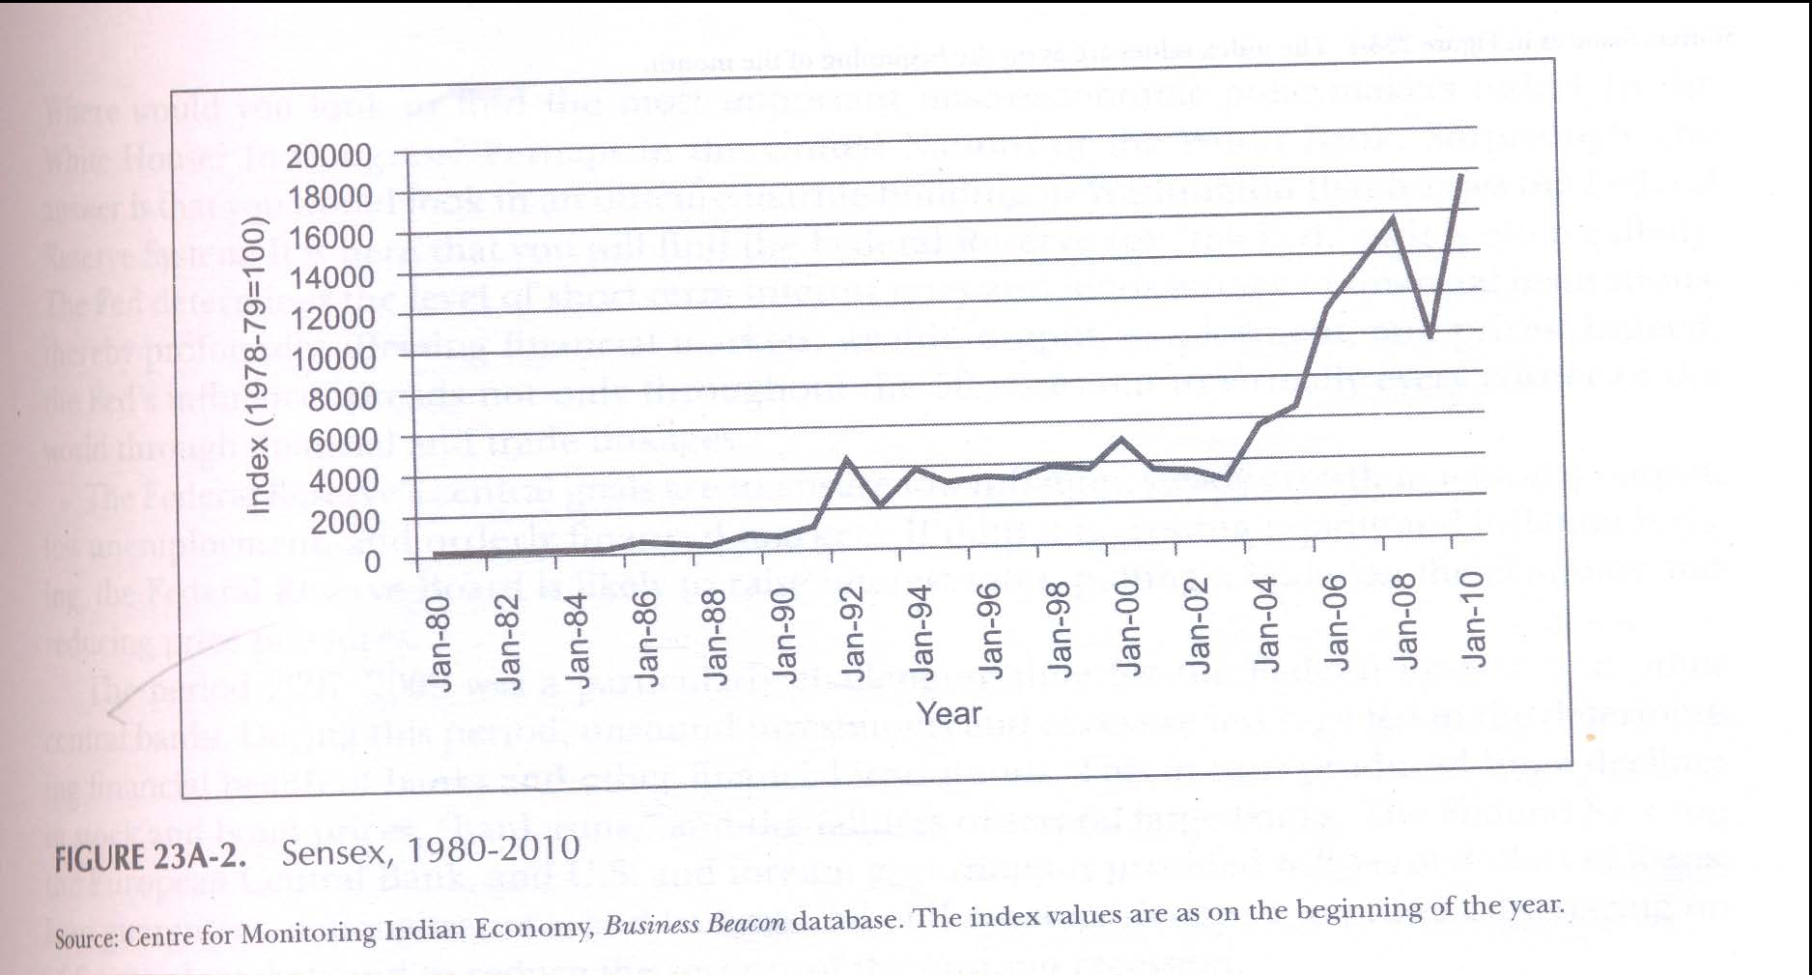
Figure 23A-2 shows, the trend of the Sensex is distinctly upward.
From 100 in 1978-79 the index crossed 2000 in 1992 and 5000 in 2001.

Slide 29
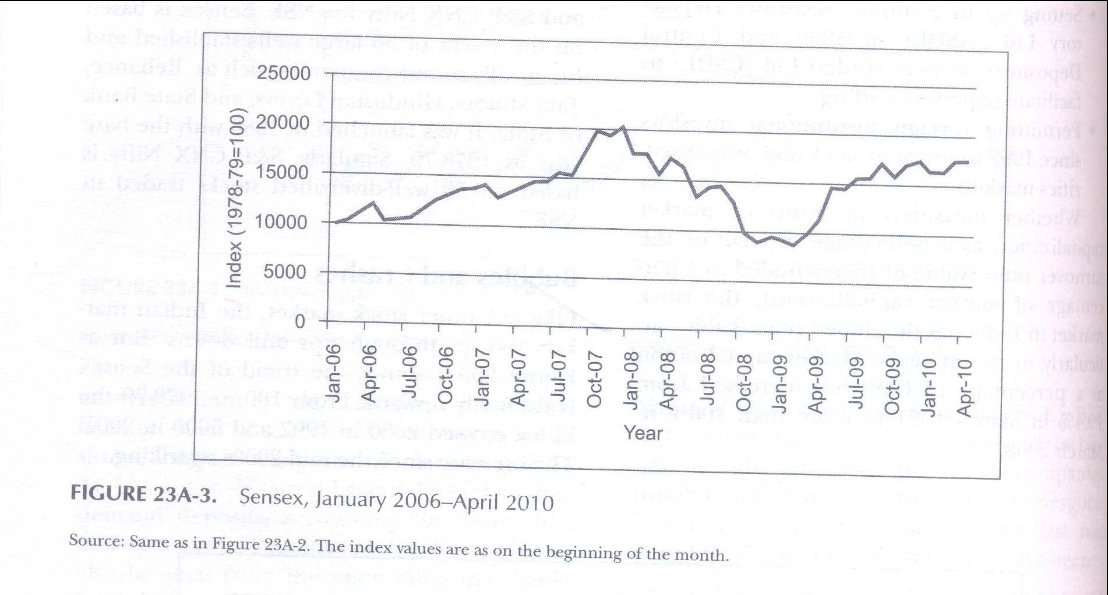
Figure 23A-3 shows how from an index of 10000 in the early 2006, it went up to more than 20000 in the early 2008.
But Sensex crashed to less than 8000 in late November 2008 before again recovering to some extent.

